Slide 1
Easy Job
Time-Consuming
Lengthy applications drain candidate energy
Mismatched Roles
Expectations misaligned with reality
A STEM-Focused Job Matchmaking Platform
COM370-B01 | Adv. Computer Programming
Alish Pandey · Gauri Shrestha · Jawad Zaman · Srijana Shrestha · Nirvika Poudel
Overwhelming Boards
LinkedIn noise drowns relevant jobs
Professor: Eleni Zamagias | May 6, 2026
Limited Filtering
Handshake lacks advanced search

Slide 2
The Challenge in STEM Hiring
Time-Consuming
Lengthy applications drain candidate energy
Mismatched Roles
Expectations misaligned with reality
Overwhelming Boards
LinkedIn noise drowns relevant jobs
Limited Filtering
Handshake lacks advanced search
02
KEY DIFFERENTIATORS

Slide 3
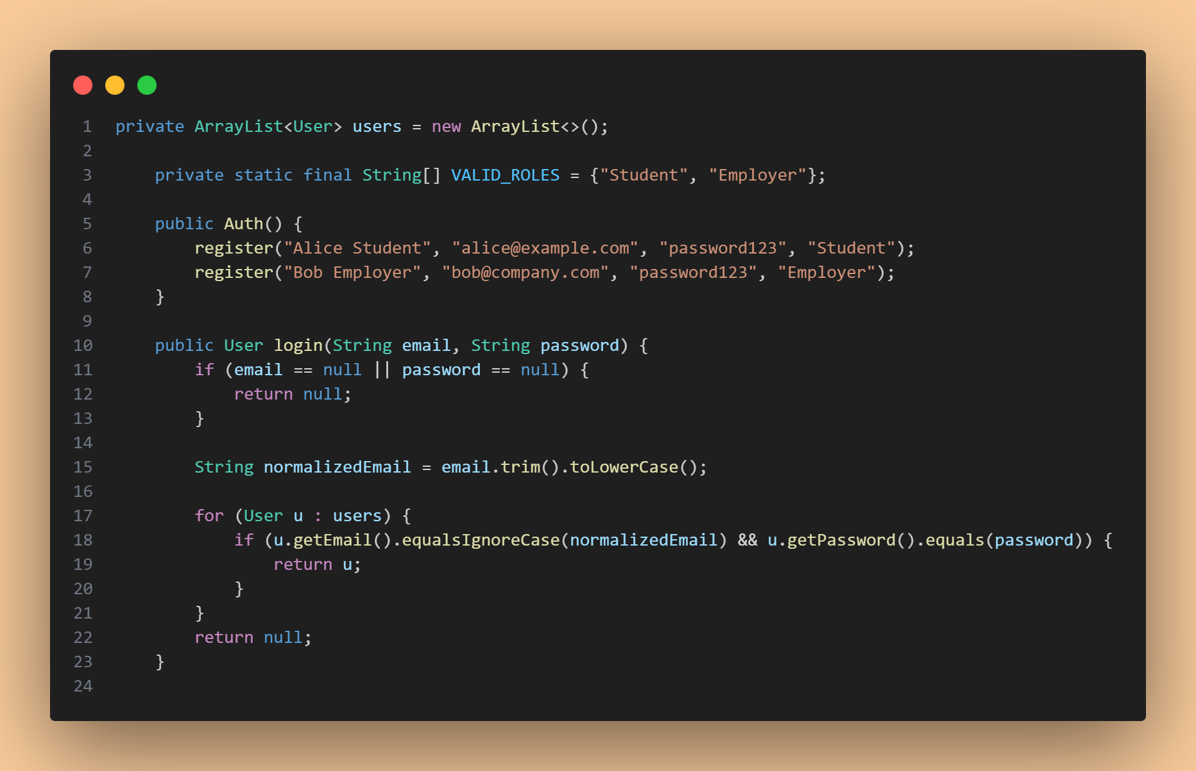
Why Easy Job?
Feature | LinkedIn | Handshake | Easy Job
Swipe-to-Match | No | No | Yes
STEM-Focused | Partial | Partial | Yes
Advanced Filters | Basic | Limited | Yes
Mutual-Match Alerts | No | No | Yes
Time-Consuming
Lengthy applications drain candidate energy
Mismatched Roles
Expectations misaligned with reality
KEY DIFFERENTIATORS
Swipe-to-Match Interface
STEM-First Design
Overwhelming Boards
LinkedIn noise drowns relevant jobs
Limited Filtering
Handshake lacks advanced search
Smart Filtering
Mutual-Match Alerts
03

Slide 4
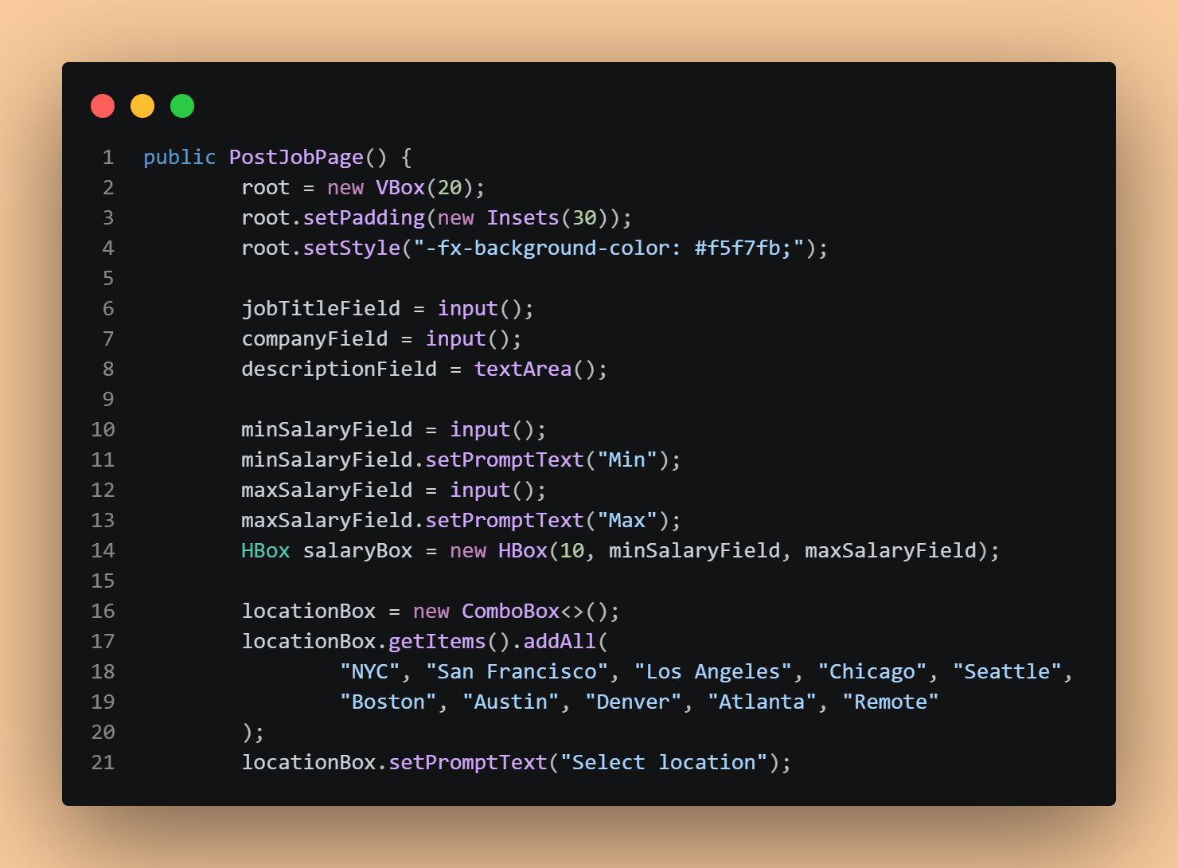
Secure & Role-Based Login/Signup
Feature | LinkedIn | Handshake | Easy Job
Swipe-to-Match | No | No | Yes
STEM-Focused | Partial | Partial | Yes
Advanced Filters | Basic | Limited | Yes
Mutual-Match Alerts | No | No | Yes
04

Slide 5
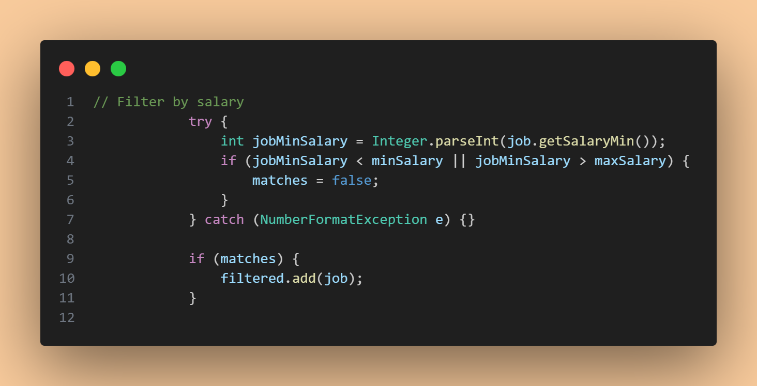
Dynamic Profile Management & Job Posting
05

Slide 6
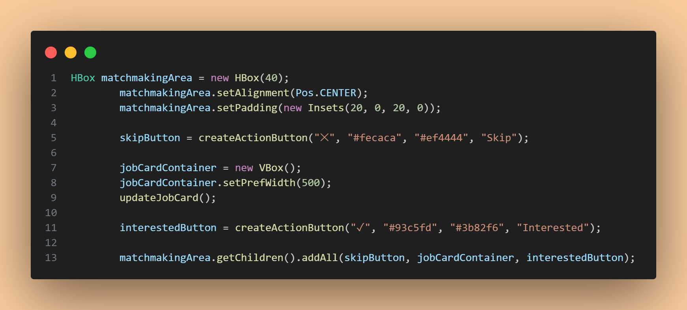
Smart Job Discovery
06

Slide 7
Intuitive Job Matchmaking
07

Slide 8
Conclusion
Easy Job simplifies the STEM hiring pipeline from discovery to match
Core Java + JavaFX proves robust desktop apps need no heavy frameworks
Modular architecture enables smooth migration to database + mobile
Future AI matching will elevate precision beyond keyword filtering
Easy Job bridges the gap between STEM talent and opportunity.
Thank you!
08

Slide 9
Questions?
Thank you for your time.

